Slide 1
Logistic Regression & Case Study

Slide 2
Session outline
Classification models
Logistic Regression-
Python Implementation of Logistic Regression

Slide 3
Classification models
The Classification algorithm is a Supervised Learning technique that is used to identify the category of new observations on the basis of training data.
In Classification, a program learns from the given dataset or observations and then classifies new observation into a number of classes or groups.
Such as, Yes or No, 0 or 1, Spam or Not Spam, cat or dog, etc. Classes can be called as targets/labels or categories.
Unlike regression, the output variable of Classification is a category, not a value, such as "Green or Blue", "fruit or animal", etc.
Since the Classification algorithm is a Supervised learning technique, hence it takes labeled input data, which means it contains input with the corresponding output.
In classification algorithm, a discrete output function(y) is mapped to input variable(x).

Slide 4
y=f(x), where y = categorical output
The best example of an ML classification algorithm is Email Spam Detector.
The main goal of the Classification algorithm is to identify the category of a given dataset, and these algorithms are mainly used to predict the output for the categorical data.
Classification algorithms can be better understood using the below diagram.
In the below diagram, there are two classes, class A and Class B.
These classes have features that are similar to each other and dissimilar to other classes.

Slide 5
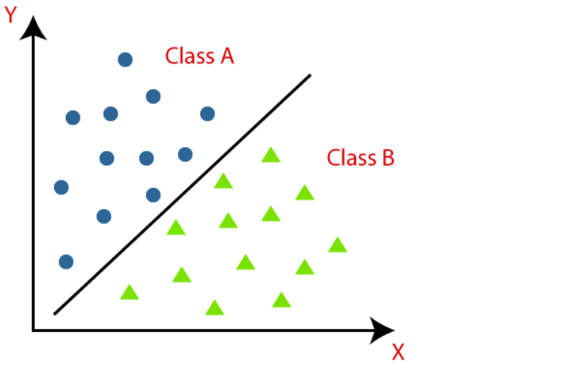

Slide 6
The algorithm which implements the classification on a dataset is known as a classifier.
There are two types of Classifications:
Binary Classifier: If the classification problem has only two possible outcomes, then it is called as Binary Classifier. Examples: YES or NO, MALE or FEMALE, SPAM or NOT SPAM, CAT or DOG, etc.
Multi-class Classifier: If a classification problem has more than two outcomes, then it is called as Multi-class Classifier. Example: Classifications of types of crops, Classification of types of music.

Slide 7
Learners in Classification Problems:
In the classification problems, there are two types of learners:
Lazy Learners: Lazy Learner firstly stores the training dataset and wait until it receives the test dataset. In Lazy learner case, classification is done on the basis of the most related data stored in the training dataset. It takes less time in training but more time for predictions. Example: K-NN algorithm, Case-based reasoning
Eager Learners:Eager Learners develop a classification model based on a training dataset before receiving a test dataset. Opposite to Lazy learners, Eager Learner takes more time in learning, and less time in prediction. Example: Decision Trees, Naïve Bayes, ANN.

Slide 8
Types of ML Classification Algorithms:
Classification Algorithms can be further divided into the Mainly two category:
Linear Models
Logistic Regression
Support Vector Machines
Non-linear Models
K-Nearest Neighbours
Kernel SVM
Naïve Bayes
Decision Tree Classification
Random Forest Classification

Slide 9
Evaluating a Classification model:
Once our model is completed, it is necessary to evaluate its performance; either it is a Classification or Regression model. So for evaluating a Classification model, we have the following ways:
1. Log Loss or Cross-Entropy Loss:
It is used for evaluating the performance of a classifier, whose output is a probability value between the 0 and 1.
For a good binary Classification model, the value of log loss should be near to 0.
The value of log loss increases if the predicted value deviates from the actual value.
The lower log loss represents the higher accuracy of the model.

Slide 10

2. Confusion Matrix:
The confusion matrix provides us a matrix/table as output and describes the performance of the model.
It is also known as the error matrix.
The matrix consists of predictions result in a summarized form, which has a total number of correct predictions and incorrect predictions. The matrix looks like as below table:
Actual Positive | Actual Negative
Predicted Positive | True Positive | False Positive
Predicted Negative | False Negative | True Negative

Slide 11
3. AUC-ROC curve:
ROC curve stands for Receiver Operating Characteristics Curve and AUC stands for Area Under the Curve.
It is a graph that shows the performance of the classification model at different thresholds.
To visualize the performance of the multi-class classification model, we use the AUC-ROC Curve.
The ROC curve is plotted with TPR and FPR, where TPR (True Positive Rate) on Y-axis and FPR(False Positive Rate) on X-axis

Slide 12
Use cases of Classification Algorithms
Classification algorithms can be used in different places. Below are some popular use cases of Classification Algorithms:
Email Spam Detection
Speech Recognition
Identifications of Cancer tumor cells.
Drugs Classification
Biometric Identification, etc.

Slide 13
Logistic Regression in Machine Learning
Logistic regression is one of the most popular Machine Learning algorithms, which comes under the Supervised Learning technique.
It is used for predicting the categorical dependent variable using a given set of independent variables.
Logistic regression predicts the output of a categorical dependent variable.
Therefore the outcome must be a categorical or discrete value. It can be either Yes or No, 0 or 1, true or False, etc. but instead of giving the exact value as 0 and 1, it gives the probabilistic values which lie between 0 and 1.
Logistic Regression is much similar to the Linear Regression except that how they are used.
Linear Regression is used for solving Regression problems, whereas Logistic regression is used for solving the classification problems

Slide 14
In Logistic regression, instead of fitting a regression line, we fit an "S" shaped logistic function, which predicts two maximum values (0 or 1).
The curve from the logistic function indicates the likelihood of something such as whether the cells are cancerous or not, a mouse is obese or not based on its weight, etc.
Logistic Regression is a significant machine learning algorithm because it has the ability to provide probabilities and classify new data using continuous and discrete datasets.
Logistic Regression can be used to classify the observations using different types of data and can easily determine the most effective variables used for the classification. The below image is showing the logistic function:

Slide 15
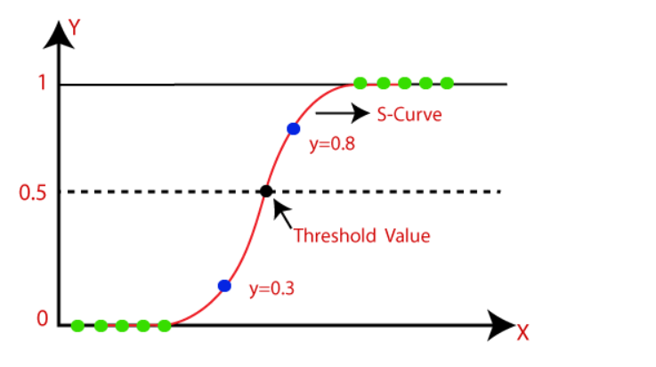

Slide 16
Logistic Function (Sigmoid Function):
The sigmoid function is a mathematical function used to map the predicted values to probabilities.
It maps any real value into another value within a range of 0 and 1.
The value of the logistic regression must be between 0 and 1, which cannot go beyond this limit, so it forms a curve like the "S" form. The S-form curve is called the Sigmoid function or the logistic function.
In logistic regression, we use the concept of the threshold value, which defines the probability of either 0 or 1. Such as values above the threshold value tends to 1, and a value below the threshold values tends to 0.

Slide 17
Assumptions for Logistic Regression:
The dependent variable must be categorical in nature.
The independent variable should not have multi-collinearity.

Slide 18


Logistic Regression Equation:
he Logistic regression equation can be obtained from the Linear Regression equation. The mathematical steps to get Logistic Regression equations are given below:
We know the equation of the straight line can be written as:
In Logistic Regression y can be between 0 and 1 only, so for this let's divide the above equation by (1-y):

Slide 19

But we need range between -[infinity] to +[infinity], then take logarithm of the equation it will become:

Slide 20
Type of Logistic Regression:
On the basis of the categories, Logistic Regression can be classified into three types:
Binomial: In binomial Logistic regression, there can be only two possible types of the dependent variables, such as 0 or 1, Pass or Fail, etc.
Multinomial: In multinomial Logistic regression, there can be 3 or more possible unordered types of the dependent variable, such as "cat", "dogs", or "sheep"
Ordinal: In ordinal Logistic regression, there can be 3 or more possible ordered types of dependent variables, such as "low", "Medium", or "High".

Slide 21
What is a confusion matrix?
It is a table that is used in classification problems to assess where errors in the model were made.
The rows represent the actual classes the outcomes should have been.
While the columns represent the predictions we have made.
Using this table it is easy to see which predictions are wrong.
Some features of Confusion matrix are given below:

Slide 22
For the 2 prediction classes of classifiers, the matrix is of 2*2 table, for 3 classes, it is 3*3 table, and so on.
The matrix is divided into two dimensions, that are predicted values and actual values along with the total number of predictions.
Predicted values are those values, which are predicted by the model, and actual values are the true values for the given observations.

Slide 23
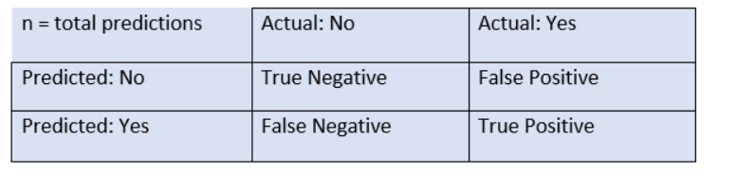

Slide 24
True Negative: Model has given prediction No, and the real or actual value was also No.
True Positive: The model has predicted yes, and the actual value was also true.
False Negative: The model has predicted no, but the actual value was Yes, it is also called as Type-II error.
False Positive: The model has predicted Yes, but the actual value was No. It is also called a Type-I error.

Slide 25
Need for Confusion Matrix in Machine learning
t evaluates the performance of the classification models, when they make predictions on test data, and tells how good our classification model is.
It not only tells the error made by the classifiers but also the type of errors such as it is either type-I or type-II error.
With the help of the confusion matrix, we can calculate the different parameters for the model, such as accuracy, precision, etc.

Slide 26
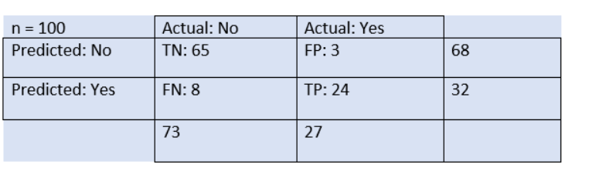
Suppose we are trying to create a model that can predict the result for the disease that is either a person has that disease or not. So, the confusion matrix for this is given as:

Slide 27
The table is given for the two-class classifier, which has two predictions "Yes" and "NO." Here, Yes defines that patient has the disease, and No defines that patient does not has that disease.
The classifier has made a total of 100 predictions. Out of 100 predictions, 89 are true predictions, and 11 are incorrect predictions.
The model has given prediction "yes" for 32 times, and "No" for 68 times. Whereas the actual "Yes" was 27, and actual "No" was 73 times.

Slide 28

Calculations using Confusion Matrix:
Classification Accuracy: It is one of the important parameters to determine the accuracy of the classification problems.
It defines how often the model predicts the correct output.
It can be calculated as the ratio of the number of correct predictions made by the classifier to all number of predictions made by the classifiers.
The formula is given below:

Slide 29

Misclassification rate: It is also termed as Error rate, and it defines how often the model gives the wrong predictions.
The value of error rate can be calculated as the number of incorrect predictions to all number of the predictions made by the classifier.
The formula is given below:

Slide 30


Precision: It can be defined as the number of correct outputs provided by the model or out of all positive classes that have predicted correctly by the model, how many of them were actually true.
It can be calculated using the below formula:
Recall: It is defined as the out of total positive classes, how our model predicted correctly. The recall must be as high as possible.

Slide 31

F-measure: If two models have low precision and high recall or vice versa, it is difficult to compare these models.
So, for this purpose, we can use F-score.
This score helps us to evaluate the recall and precision at the same time.
The F-score is maximum if the recall is equal to the precision.
It can be calculated using the below formula:

Slide 32
Problem
TP=10
FN=4
FP=5
TN=1000
FIND Accuracy,Precision,Recall

